Slide 1
Unit - II IoT Architecture
Topic - I

Slide 2
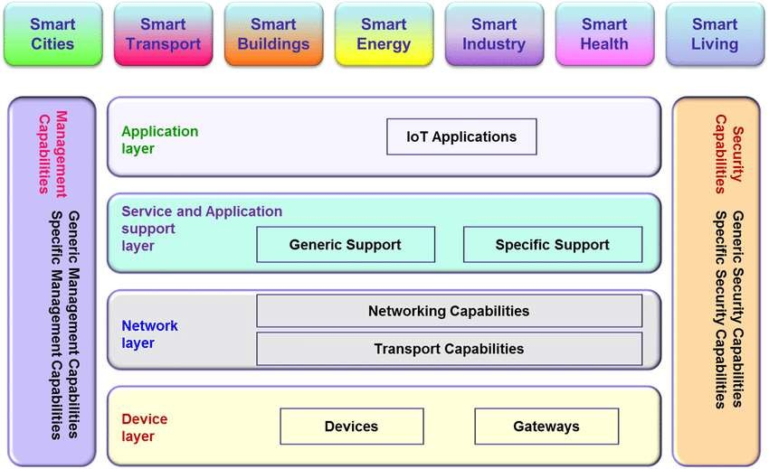
Layered Architecture

Slide 3
Device Layer
Sensors, actuators, devices are present in the Sensing layer. These Sensors or Actuators accepts data (physical/environmental parameters), processes data and emits data over network.
Provides a user interface for using IoT.
Different applications for various sectors like Transportation, Healthcare, Agriculture, Supply chains, Government, Retail etc.
Devices and sensors used are:
GPS
Gyroscope
Accelerometer
Wifi
Ethernet
Bluetooth

Slide 4
Network Layer
Internet/Network gateways, Data Acquisition System (DAS) are present in this layer.
DAS performs data aggregation and conversion function (Collecting data and aggregating data then converting analog data of sensors to digital data etc).
Advanced gateways which mainly opens up connection between Sensor networks and Internet also performs many basic gateway functionalities like malware protection, and filtering, also some times decision making based on inputted data and data management services, etc.
Robust and High performance network infrastructure.
Supports the communication requirements for latency, bandwidth or security.
Allows multiple organizations to share and use the same network independently.
Encryption, signal processing, LTE, Wifi, Sim Module, GSM, Microcontroller, Embedded-os etc are used in network layer.

Slide 5
Service Layer
Also termed as Application service Layer.
Capturing of periodic sensory data.
This is processing unit of IoT ecosystem.
Here data is analyzed and pre-processed before sending it to data center from where data is accessed by software applications often termed as business applications where data is monitored and managed and further actions are also prepared.
So here Edge IT or edge analytics comes into picture.
Data Analytics (Extracts relevant information from massive amount of raw data).
Streaming Analytics (Process real time data).
Ensures security and privacy of data.

Slide 6
Application Layer
This is last layer of 4 stages of IoT architecture. Also known as Lowest Abstraction Layer.
Data centers or cloud is management stage of data where data is managed and is used by end-user applications like agriculture, health care, aerospace, farming, defense, etc.
With sensors we are creating digital nervous system.
Incorporated to measure physical quantities.
Interconnects the physical and digital world.
Collects and process the real time information.
Transportation, Health care, Tracing people, Climatic conditions etc comes under application layer.

Slide 7
Elements of IoT Architecture
Things
Gateways
Cloud Gateways
Streaming data processor
Data Lake
Big data warehouse
Data Analytics
Machine learning and the models ML generates
Control Applications
User Applications

Slide 8
Things
A “thing” is an object equipped with sensors that gather data that will be transferred over a network and actuators that allow things to act.
Example : to switch on or off the light, to open or close a door, to increase or decrease engine rotation speed.
This concept includes fridges, street lamps, buildings, vehicles, production machinery, rehabilitation equipment and everything else imaginable.
Sensors are not in all cases physically attached to the things: sensors may need to monitor, for example, what happens in the closest environment to a thing.

Slide 9
Gateways
Data goes from things to the cloud and vice versa through the gateways.
A gateway provides connectivity between things and the cloud part of the IoT solution, enables data preprocessing and filtering before moving it to the cloud (to reduce the volume of data for detailed processing and storing) and transmits control commands going from the cloud to things.
Things then execute commands using their actuators.

Slide 10
Cloud gateway
Cloud gateway facilitates data compression and secure data transmission between field gateways and cloud IoT servers.
It also ensures compatibility with various protocols and communicates with field gateways using different protocols depending on what protocol is supported by gateways.

Slide 11
Streaming data processor, Data Lake
Streaming data processor
It ensures effective transition of input data to a data lake and control applications.
No data can be occasionally lost or corrupted.
Data lake
A data lake is used for storing the data generated by connected devices in its natural format.
Big data comes in "batches" or in “streams”.
When the data is needed for meaningful insights it’s extracted from a data lake and loaded to a big data warehouse.

Slide 12
Big data warehouse
Filtered and preprocessed data needed for meaningful insights is extracted from a data lake to a big data warehouse.
A big data warehouse contains only cleaned, structured, and matched data.
Also, data warehouse stores context information about things and sensors (for example, where sensors are installed) and the commands control applications send to things.

Slide 13
Data analytics
Data analysts can use data from the big data warehouse to find trends and gain actionable insights.
When analyzed big data show, for example, the performance of devices, help identify inefficiencies and work out the ways to improve an IoT system (make it more reliable, more customer-oriented).
Also, the correlations and patterns found manually can further contribute to creating algorithms for control applications.

Slide 14
Machine learning and the models ML generates
With machine learning, there is an opportunity to create more precise and more efficient models for control applications.
Models are regularly updated (for example, once a week or once a month) based on the historical data accumulated in a big data warehouse.
When the applicability and efficiency of new models are tested and approved by data analysts, new models are used by control applications.

Slide 15
Control applications
It send automatic commands and alerts to actuators, for example:
Windows of a smart home can receive an automatic command to open or close depending on the forecasts taken from the weather service.
When sensors show that the soil is dry, watering systems get an automatic command to water plants.
Sensors help monitor the state of industrial equipment, and in case of a pre-failure situation, an IoT system generates and sends automatic notifications to field engineers.
The commands sent by control apps to actuators can be also additionally stored in a big data warehouse. This may help investigate problematic cases.
Example: A control app sends commands, but they are not performed by actuators – then connectivity, gateways and actuators need to be checked.
On the other side, storing commands from control apps may contribute to security.

Slide 16
Control applications Cont….
Control applications can be either rule-based or machine-learning based. In the first case, control apps work according to the rules stated by specialists. In the second case, control apps are using models which are regularly updated (once in a week, once in a month depending on the specifics of an IoT system) with the historical data stored in a big data warehouse.
Although control apps ensure better automation of an IoT system, there should be always an option for users to influence the behavior of such applications (for example, in cases of emergency or when it turns out that an IoT system is badly tuned to perform certain actions).

Slide 17
User applications
User applications are software components of an IoT system that enable the connection of users to an IoT system and give the options to monitor and control their smart things.
Example: homes or cars and controlled by a central system.
With a mobile or web app, users can monitor the state of their things, send commands to control applications, set the options of automatic behavior (automatic notifications and actions when certain data comes from sensors).

